Slide 1

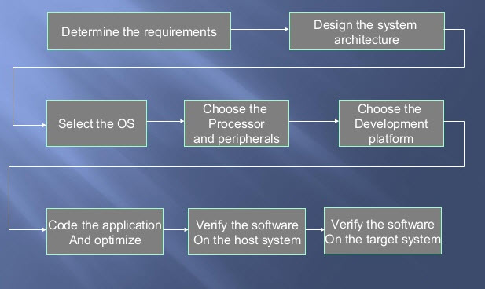
OPTIONAL
LOGO HERE
Poster Presentation
Sayali R. Kshirsagar & Trupti G. Ghumade
JSPM’S RAJARSHI SHAHU COLLEGE OF ENGINEERING , PUNE
OPTIONAL
LOGO HERE
Name Of The Subject
Course Outcomes From Syllabus
Important Concepts
Protocols Used & Scheduling Algorithms In ERTOS
Recognize and classify embedded and real-time systems.
Explain communication bus protocols used for embedded and real-time systems.
Classify and exemplify scheduling algorithms.
Apply software development process to a given RTOS application.
Design a given RTOS based application
Embedded system, its constituents and the selection process of processor and memory for the embedded systems
Communication buses and protocols used in the embedded and real-time systems
Real-time operating system (RTOS), types of RTOS, temporal, functional and resource parameters of an RTOS process
Various approaches to real-time scheduling and scheduling algorithms and multiprocessor scheduling
Resource access control and inter-process communication for RTOS tasks
Software development process, tools and debugging for RTOS applications
Designing of RTOS based applications
.
Networked embedded systems- I2C, CAN, USB, Fire wire.
Internet enabled systems- TCP, IP, UDP.
Wireless and mobile system Protocols- IrDA, Bluetooth, 802.11, ZigBee
Serial protocols, Devices and buses- RS-232C, RS-485, HDLC, SPI, SCI, SI, SDIO.
Parallel device protocols: ISA, PCI, PCI/X, ARM bus
Approaches to real-time scheduling: clock driver, weighted round-robin, priority-driven- Fixed priority and dynamic priority algorithms –Rate Monotonic (RM), Earliest-Deadline-First (EDF), Latest-Release-Time (LRT), Least-SlackTime-First (LST). Static and Dynamic systems, on-line and off-line scheduling, Scheduling aperiodic and sporadic real-time tasks
Embedded And
Real Time Operating System
Recent Paper
SysWCET: Whole-System Response-Time Analysis for Fixed-Priority Real-Time Systems
Published in: Real-Time and Embedded Technology and Applications Symposium (RTAS), 2017 IEEE
Date of Conference: 18-21 April 2017
INSPEC Accession Number: 16947988
Literature Survey
The worst-case response time (WCRT) - the time span from release to completion of a real-time task - is a crucial property of real-time systems. However, WCRT analysis is complex in practice, as it depends not only on the realistic examination of worst-case execution times (WCET), but also on system-level overheads and blocking/preemption times. While the implicit path enumeration technique (IPET) has greatly improved automated WCET analysis, the resulting values still need to be aggregated manually with the system-level overheads - an errorprone and tedious process that yields overly pessimistic results. With SysWCET, we provide an integrated approach for the automated WCRT analysis across multiple threads of execution, locks, interrupt service routines, and the real-time operating system (RTOS) in particular..
Applications
Latest Smart TVs
GPS Navigation Systems
Almost all Modern Day Smart Phones
Missile Guidance Systems
Space Exploration (Rovers)
Automobiles (ABS, Airbags)
Industries (Assembly Robots)
Road Safety Systems (Traffic Monitoring and Collision Alert Systems)
Automatic Chocolate Vending Machine.
And many more
Software Development Life Cycle of Embedded System

